Slide 1


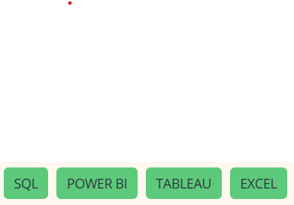
Kickstarter Crowdfunding Project
BY: Abhishek Deshmukh

Slide 2







01
Project Overview
Problem
Many Kickstarter projects fail due to poor goal setting, category choice, and launch timing
Creators lack data-driven insights on what drives success
Analysis of historical Kickstarter data to understand why projects succeed or fail.
Focuses on goal amount, category, timing, and other key factors to improve success rates.
Dataset
Objective
Historical Kickstarter project data
Attributes: category, goal, pledged amount, backers, duration, location, outcome
Identify key success and failure factors
Provide actionable insights to improve success rates
03
02

Slide 3





Data & Tools Used
Excel
Initial data validation and exploratory analysis
Power BI
KPI metrics, interactive dashboards, trend analysis
Tableau
Advanced visualizations and comparative insights
SQL
Data extraction, joins, filtering, metric calculations
Raw Data → Cleaning → Transformation → Analysis → Visualization

Slide 4
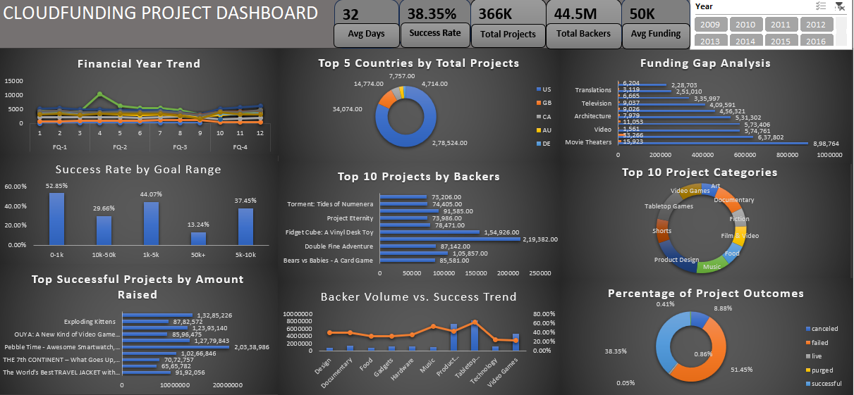
Excel
Dashboard

Slide 5
Challenges
Advantages
Disadvantages
Manual fixes caused cascading errors during data cleaning
Timestamp-to-date conversion required complex formulas
Excel performance degraded with large datasets
Easy visual inspection to quickly identify obvious errors
Familiar interface ideal for initial data exploration
Fast insights using pivot tables and basic charts
Poor performance with large datasets
High risk of accidental formula or data changes

Slide 6
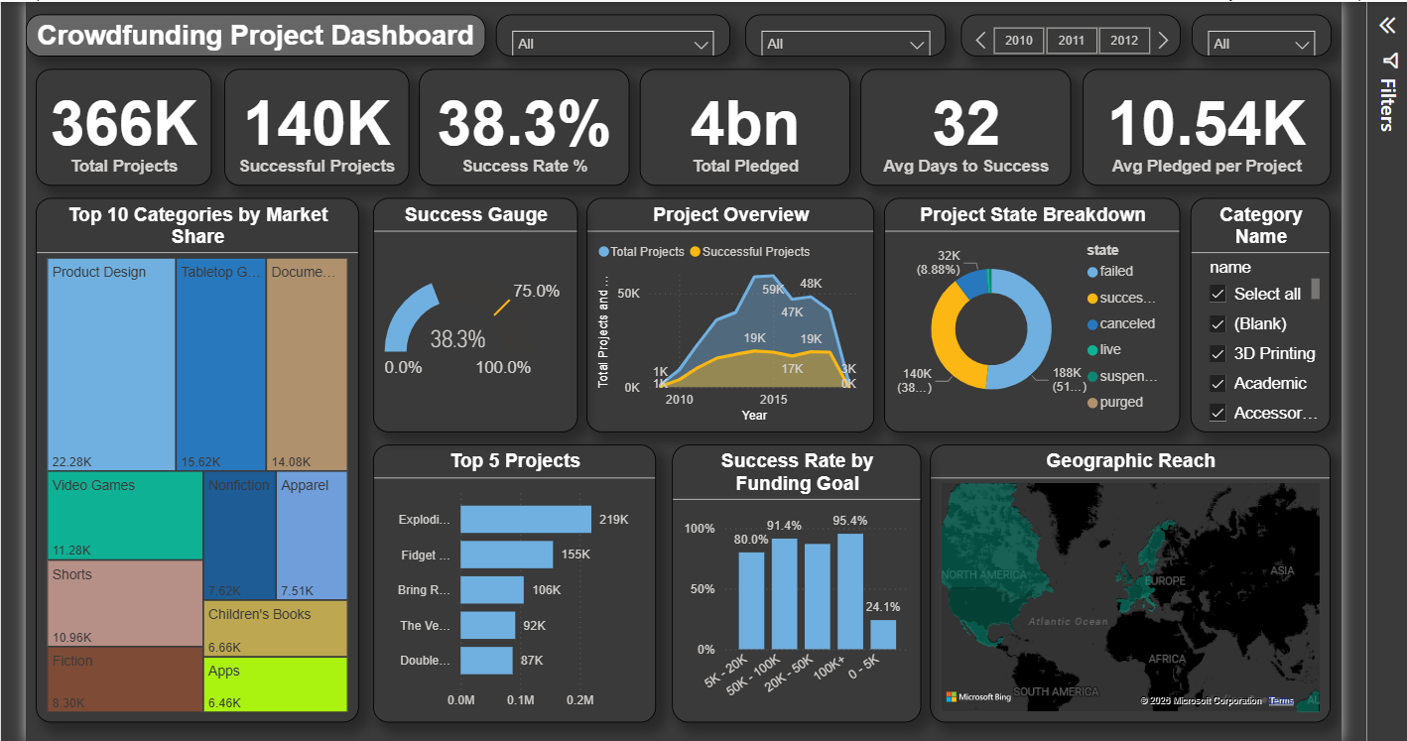
Power BI Dashboard

Slide 7
Challenges
Advantages
Disadvantages
Highly interactive dashboards with slicers and filters
Handles large datasets better than Excel
Easy integration with SQL, Excel, and other sources
No direct data editing; fixes require model updates
Paid license needed for sharing and collaboration
Strong dependency on clean, well-modeled data
Steep DAX learning curve, especially filter context
Incorrect data relationships can break visuals
Performance depends on the model and calculation design

Slide 8
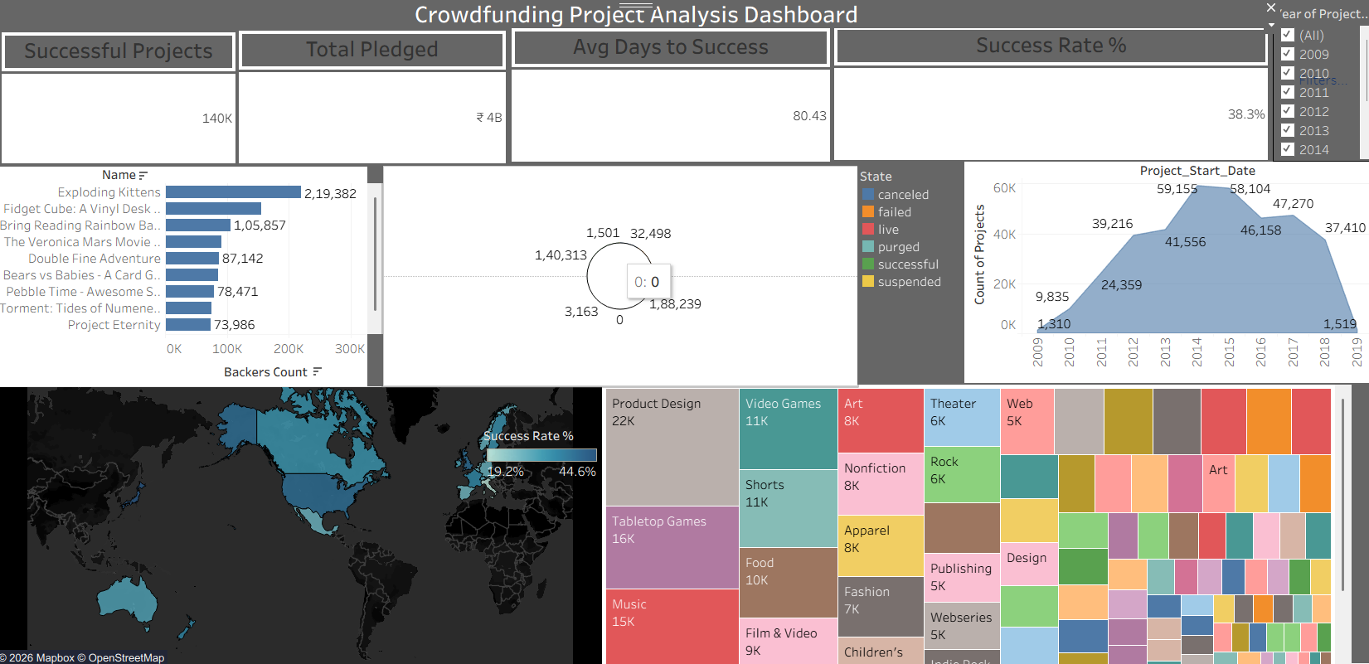
Tableau Dashboard

Slide 9
Challenges
Advantages
Disadvantages
Requires very clean data; formatting issues break visuals
Calculated Fields and LOD expressions have a learning curve
Limited layout control makes dashboard alignment time-consuming
Story feature enables step-by-step business storytelling
Performs well with large datasets
Fast drag-and-drop visual creation with interactive actions
Large workbook files make sharing difficult
Complex calculations less flexible than Power BI (DAX)
Dashboards may not scale perfectly across screen sizes

Slide 10
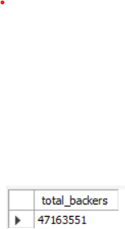
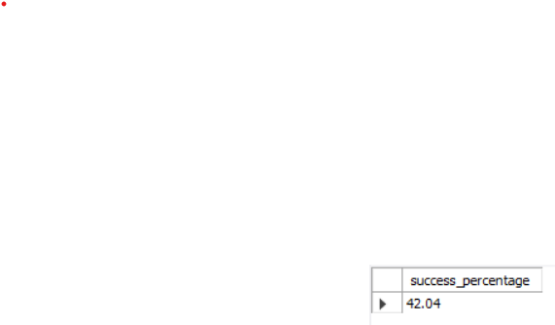
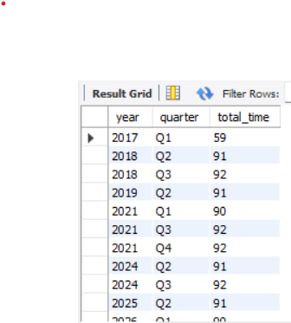
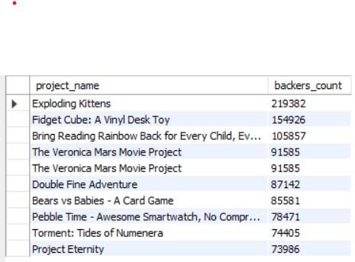
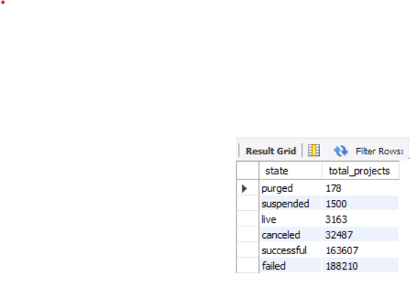
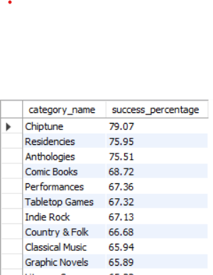
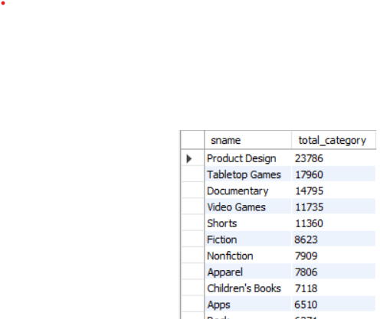
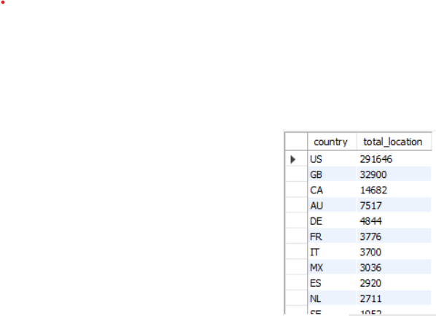
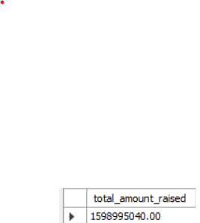
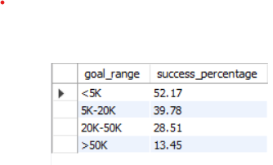
SQL Dashboard

Slide 11
Challenges
Advantages
Disadvantages
Joins and subqueries are error-prone and sensitive to business logic
Debugging complex queries is time-consuming without visual feedback
Performance and connection stability issues with very large datasets
No visual interface for data validation
Risk of permanent data loss with destructive commands
Requires database access, setup, and permissions
Poorly written queries can impact system performance
Not suitable for unstructured data
Very fast processing once queries are optimized
Most reliable tool for data cleaning and transformations (dates, epoch, aggregations)
Efficient handling of large structured datasets

Slide 12





Key Insights
04
01
Launch timing influences success
Example: Certain months consistently outperform year-end launches.
Lower funding goals have higher success rates
Example: Projects below $10K outperform those above $50K.
03
02
Geography impacts performance
Example: Projects from the US and UK achieve higher success rates.
Category selection significantly affects outcomes
Example: Games and Design categories show higher success than niche categories.

Slide 13





Set realistic funding goals
Recommendation: First-time creators should target lower goal ranges to increase success probability.
Focus on high-performing categories
Recommendation: Prioritize categories like Games and Design with proven success rates.
Recommendations
for
Stakeholders
Optimize launch timing
Recommendation: Avoid low-performing months and launch during historically strong periods.
Adopt a data-driven approach
Recommendation: Use historical Kickstarter trends instead of assumptions before launching.

Slide 14












Key Learnings
Cleaned and transformed large datasets using SQL
Handled epoch time and campaign duration calculations
Built interactive dashboards using Power BI and Tableau

Slide 15








Conclusion
02
03
01
04
Projects with realistic goals and strong category fit perform significantly better
Data-driven analysis helps creators reduce risk and make better launch decisions
Crowdfunding success on Kickstarter depends on goal amount, category, timing, and geography
This project showcases end-to-end Data Analyst skills from raw data to actionable insights

Slide 16



Thank
you

